Slide 2
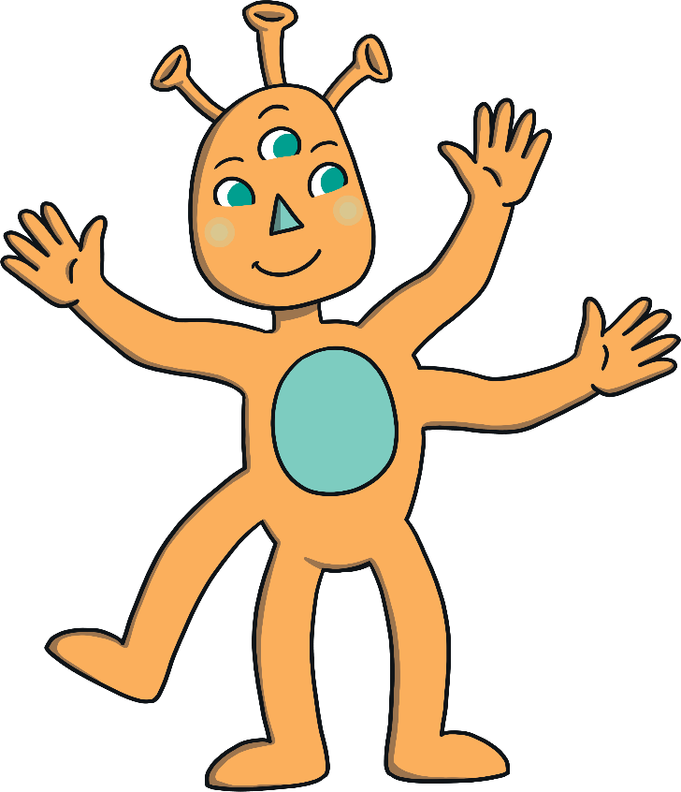
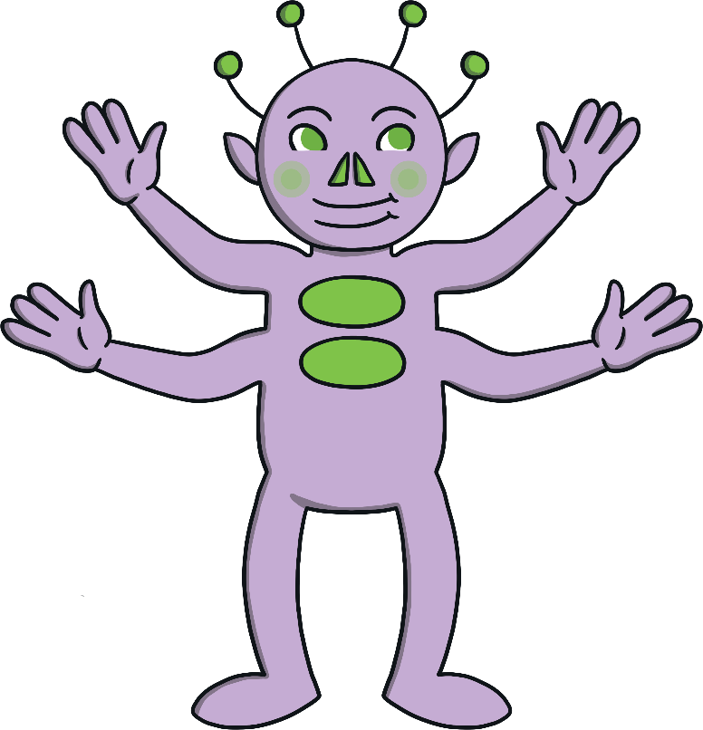
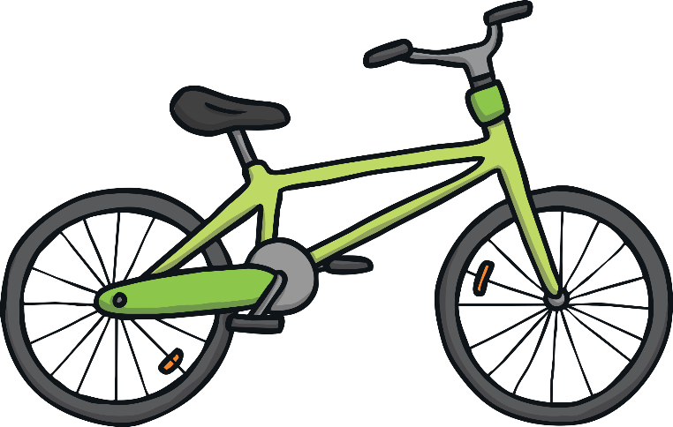
Osman Odd and Eshal Even were best friends. They did all sorts of things together; riding their bikes, playing games and going shopping.

Slide 3
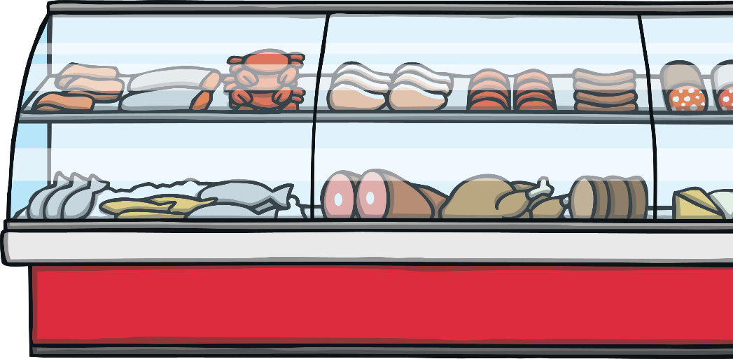
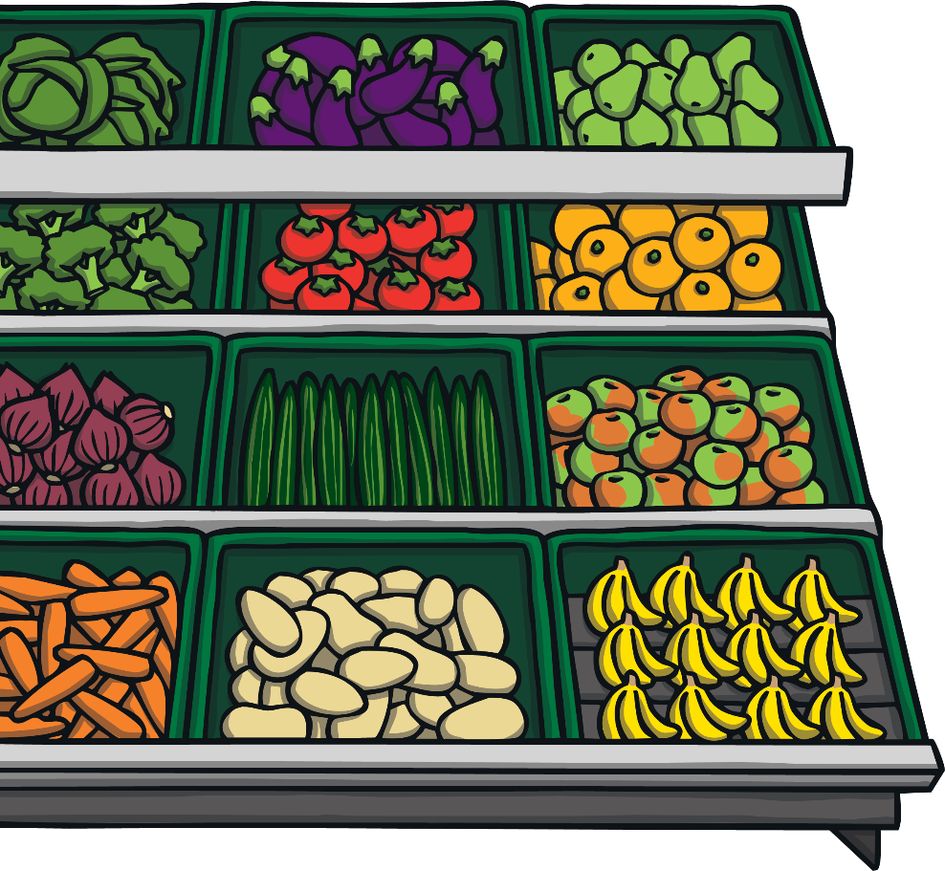
One day, Osman Odd and Eshal Even went out shopping together.
Osman Odd only ever bought items that were odd numbers and Eshal Even only bought an even number of items!

Slide 4
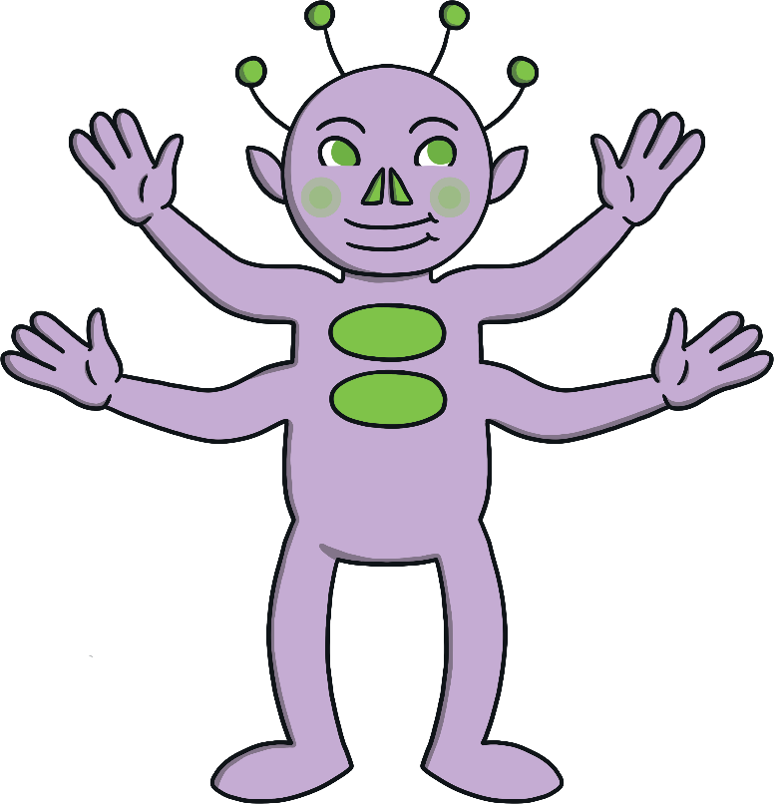
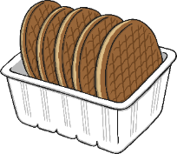
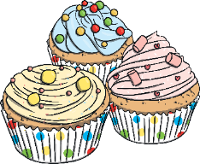
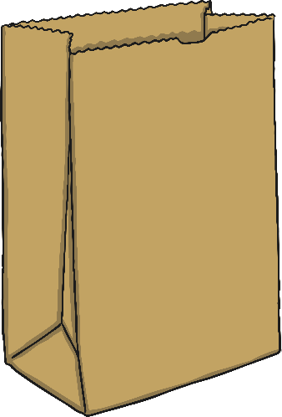
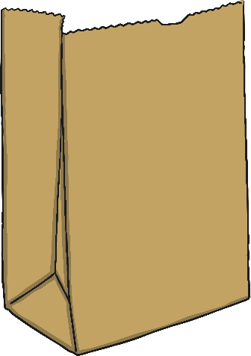
They were so excited about all the amazing treats in the shop that they filled their bags right up!

Slide 5
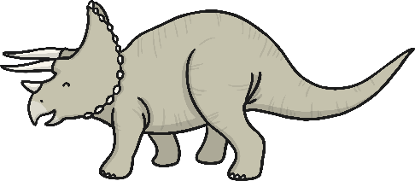
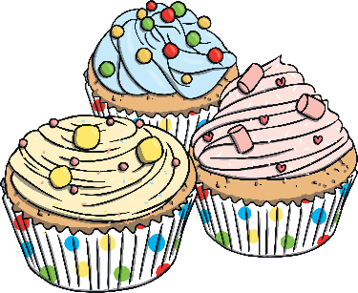
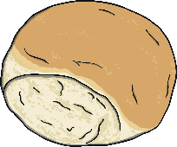
Uh-oh! Their bags were so full, that when they went outside they broke and their shopping spilled all over the floor!

Slide 6
Can you help Osman Odd and Eshal Even to put their shopping back in to the correct bags?

Slide 7
Can you put an item for Osman Odd in his bag?
Remember: Osman Odd only buys items that have an odd number!
Which item should I choose? Why do you think that?
Yes! I bought this because it has 3 cakes. 3 is an odd number.
Try again.

Slide 8
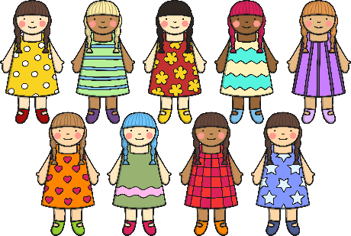
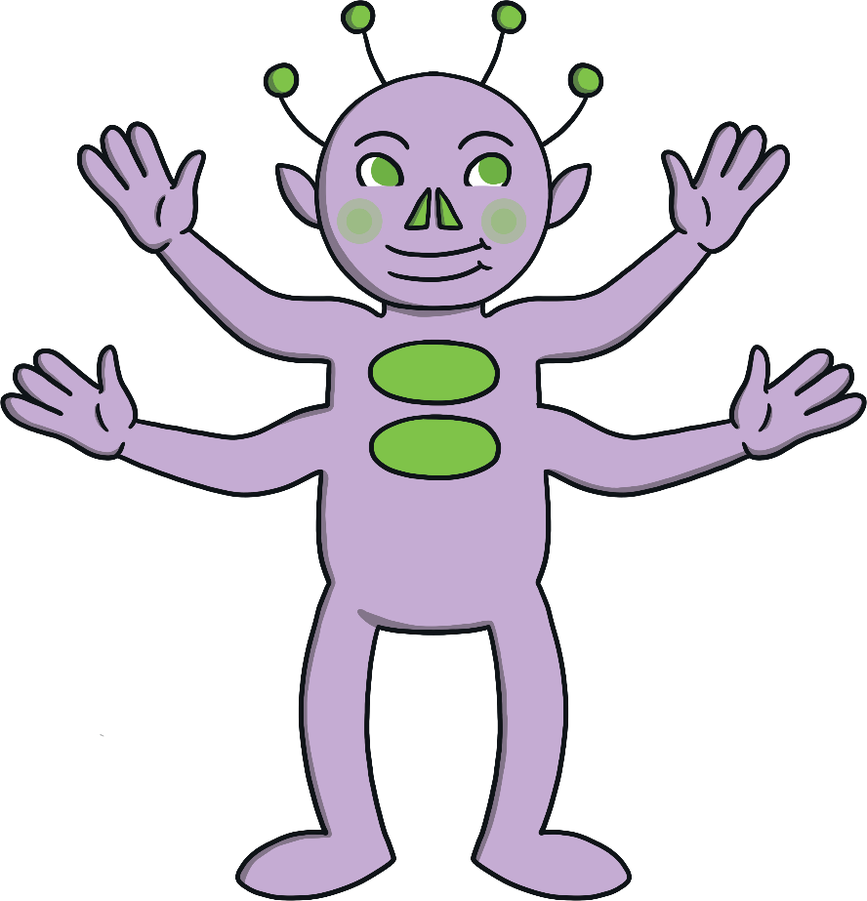
Can you put an item for Eshal Even in her bag?
Remember: Eshal Even only buys items that have an even number!
Which item should I choose? Why do you think that?
Yes! I bought this because it has 2 strawberries. 2 is an even number.
Try again.

Slide 9
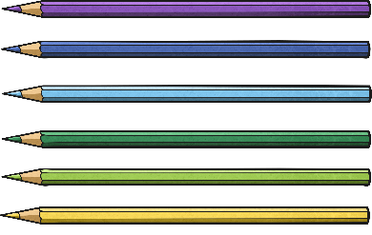
Can you put an item for Osman Odd in his bag?
Remember: Osman Odd only buys items that have an odd number!
How do you know which item is odd or even?
Yes! I bought this because it has 5 biscuits. 5 is an odd number.
Try again.

Slide 10
Can you put an item for Eshal Even in her bag?
Remember: Eshal Even only buys items that have an even number!
Can you work out which item I need to put in my bag?
Yes! I bought this because it has 6 crayons. 6 is an even number.
Try again.

Slide 11
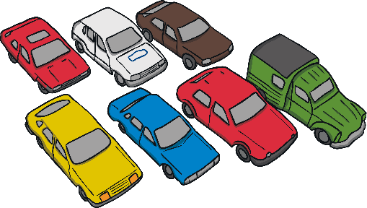
Can you put an item for Osman Odd in his bag?
Remember: Osman Odd only buys items that have an odd number!
I think I need to put the lollipops in my bag? Am I right?
You are right! I bought this because it has 7 cars. 7 is an odd number.
Try again.

Slide 12
Can you put an item for Eshal Even in her bag?
Remember: Eshal Even only buys items that have an even number!
I think I need to put the presents in my bag? Am I right?
Yes! I bought this because it has 4 presents. 4 is an even number.
Try again.

Slide 13
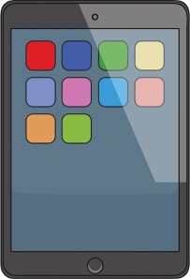
Can you put an item for Osman Odd in his bag?
Remember: Osman Odd only buys items that have an odd number!
Which item is odd? How do you know?
Yes! I bought this because it is 1 tablet. 1 is an odd number.
Try again.

Slide 14
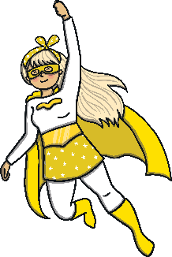
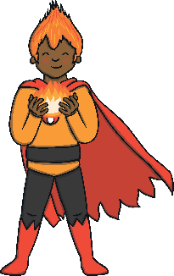
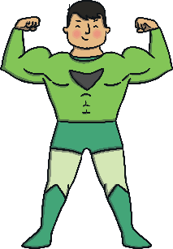
Can you put an item for Eshal Even in her bag?
Remember: Eshal Even only buys items that have an even number!
Can you help me work out which item is even?
Yes! I bought this because it has 8 sweets. 8 is an even number.
Try again.

Slide 15
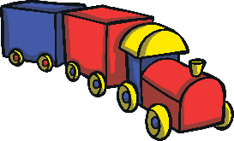
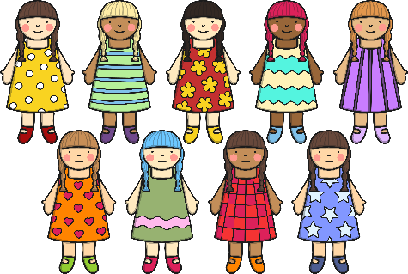
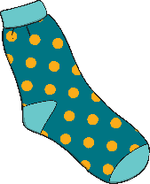
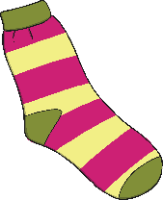
Can you put an item for Osman Odd in his bag?
Remember: Osman Odd only buys items that have an odd number!
Which item is odd? How do you know?
Yes! I bought this because it has 9 dolls. 9 is an odd number.
Try again.

Slide 16
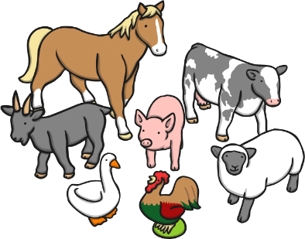
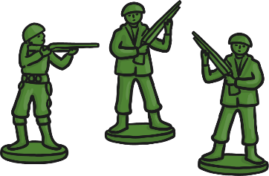
Can you put an item for Eshal Even in her bag?
Remember: Eshal Even only buys items that have an even number!
How can I work out which item has an even number?
Yes! I bought this because it has 10 doughnuts. 10 is an even number.
Try again.

Slide 17
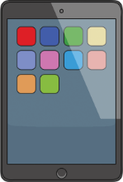
Can you remember what items went in each bag?
1
5
9
3
7
2
6
10
4
8

