Slide 1
Before you start
Parents: read our helpful guidance before you start
Mental health and emotional wellbeing
KS2 (Y5-6)
Home learning lesson:
Mental health: keeping well and managing feelings
To start, play this slideshow from
the beginning

Slide 2
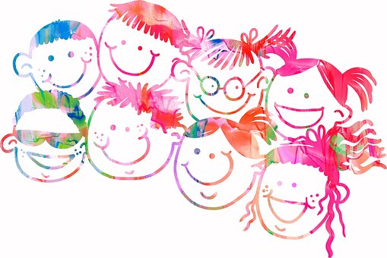
Y5-6 home learning:
Mental health: keeping well and managing feelings

Slide 3
We are learning about mental health; what it means and how we can take care of it
We will be able to:
explain what is meant by the term ‘mental health’
identify everyday behaviours that can help to support mental (and physical) health
recognise that we can take care of our mental health (as well as our physical health)

Slide 4
Mental health and keeping well:
What’s our starting point?
Imagine someone, about your age (or a bit older than you) who lives near you and goes to a school like yours.
Draw and write about the things they can do to help look after their mental health.

Slide 5
What is mental health?
Mental health means being happy all the time.
Read the statements about mental health.
Which do you feel best explains mental health? Have you got a different idea?
Mental health is about feelings and emotions; knowing how to take care of ourselves so that we can cope with things that happen to us.
Our mental health is about our feelings and emotions. People’s mental health can feel better or worse at different times, just like physical health. It is as important to take care of our mental health (minds) as our physical health (bodies).
Mental health means there is something wrong with a person and they might behave in a strange way.
Click on the box to reveal a possible answer
Mental health means that you often feel worried, anxious or depressed.
Mental health is a bit like a continuum – people can move along it and feel better or worse at different times, just like with physical health.

Slide 6
Mental health definitions
There are different definitions of mental health but most agree that it is about our thoughts and feelings, and how we behave.
The World Health Organisation describes mental health as:
‘A state of wellbeing in which every individual realises his or her own potential, can cope with the normal stresses of life, can work productively and fruitfully, and is able to make a contribution to her or his community.’
NHS England describes mental health as:
‘How we think, feel and behave’.

Slide 7
Thinking about mental health
Mental health can be thought of as a scale that can move up or down, a bit like a thermometer.
We can move along the scale at any time, between being healthy or unwell.
There are things we can do to help us stay healthy.
There are things that can be put in place if someone is not feeling so good, is struggling or unwell.

Slide 8
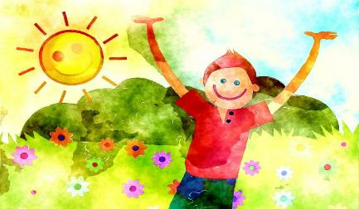
Activities for health
Organise the activities into 3 lists:
Things that support mental health
Things that support physical health
Things that support both mental and physical health
Read the Activities for health cards in your worksheet pack (Resource 1)

Slide 9
Activities for health – some answers
Your list might look similar to this...
mental health | physical health | mental and physical health
Chatting to friends Stroking a pet Drawing, painting, music Watching a funny film Learning something new Expressing your feelings Offering to do a chore Reading a good story Playing games Thinking of happy times |  | Balanced diet Drinking water Keeping your body clean Rest, relax, quiet time Getting enough sleep Going for a walk Taking medicine Talking to a trusted adult

Slide 10
What did we find out?
Answer the next two questions:
There are lots of things we can do to help support mental health.
The things that help physical health also help mental health.
Click here to reveal some things to think about
What do you notice about the lists?
Were there any things that did not help mental or physical health very much or at all?
Click here to reveal some things to think about
Some things, such as eating lots of sweets, are not so good for mental or physical health.

Slide 11
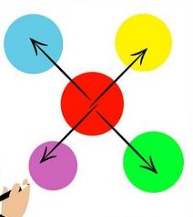
Looking after ourselves
Go back to the list or the Activities for health cards (Resource 1).
This time, organise them into four groups.
You could colour-code them, write them in lists
or make a mind-map.
Things someone could do everyday
Things someone might only do sometimes.
Things someone might do if there is a problem.
Things someone should do only rarely or not at all

Slide 12
Reflection time
Look at the Helpful for mental health list (Resource 2 in your worksheet pack). Is there anything included that you could do to help take care of your mental health everyday? What would you choose to do?

Slide 13
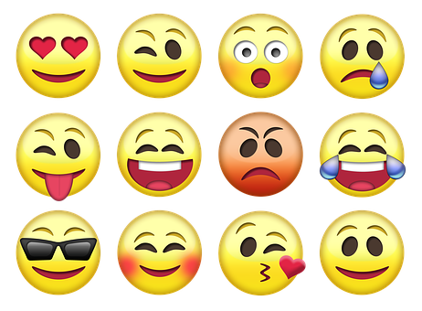
Changing feelings
Emotions and feelings change throughout the day and over time. Taking care of our mental health helps us to manage.
Feelings can grow or get stronger with time.
Some feelings seem to fade or pass over time.
Usually feelings that don’t feel so good, don’t last long.

Slide 14
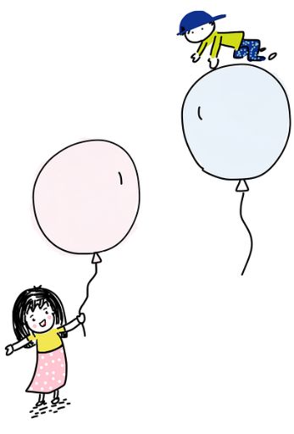
Mental health – asking for help
Expressing and talking about feelings — especially those that don’t feel so good, seem very strong, or go on for a long time — is an important part of mental health care. It is usual for people to need help with their feelings sometimes.
Read Sasha’s story on the next slide. What could help Sasha?

Slide 15
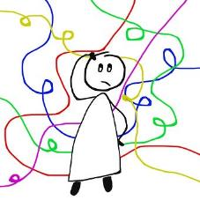
Sasha’s story
Dear Diary,
I am so confused… my emotions feel all mixed up!
One moment I feel happy and the next I feel worried and scared about everything.
I can feel my body tense, my teeth chatter and I notice my fists clench. I feel shaky.
I am concerned. It’s been happening for a while now. It’s a really strange feeling. I am sure no-one feels like me. I don’t think I can explain it to anyone.
What can I do? Will anything help?

Slide 16
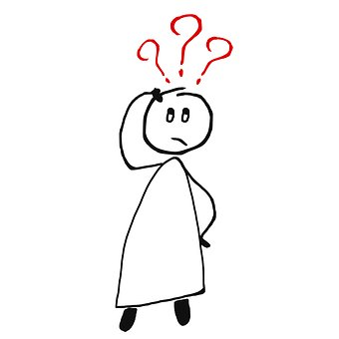
Who can help Sasha?
Friend
Teacher
Parent
Childline website www.childline.org.uk
No-one
Childine text / phone line 0800 1111
If your emotions feel all mixed up or you often have feelings that make you feel bad, talk to a trusted adult — they can help you find the right support.
Someone else

Slide 17
Mental health and keeping well:
Where are you now?
Go back to the draw and write activity from the start.
What have you learned about how people can help look after their mental health?
Is there anything you would like to change?
Is there anything you would like to add?

Slide 18
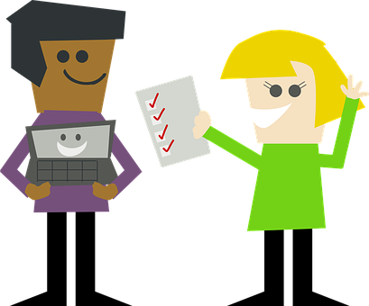
More activities
Top tips checklist
Create a top tips checklist to help people take care of their mental health.
Who might be a good audience to write for?
(other pupils in school, parents/grandparents or teachers?)

